Slide 1


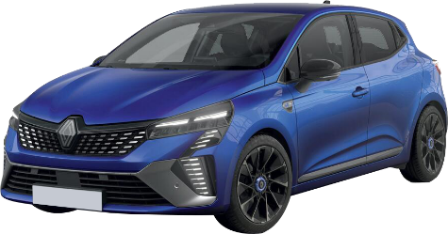
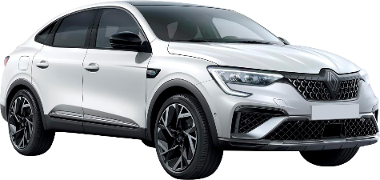
2025

Slide 2





WHO WE ARE
Global Headquarters in
Portland, Maine, USA
270 employees
European Headquarters in
Munich, Germany
150 employees
Operational Call Center in
Lisbon, Portugal
110 employees
Australian Headquarters in
Sydney, Australia
100 employees

Slide 3


OUR HISTORY
Established in 1954, Auto Europe began by providing rental cars to members of the Armed Forces for their personal use while traveling overseas

Slide 4
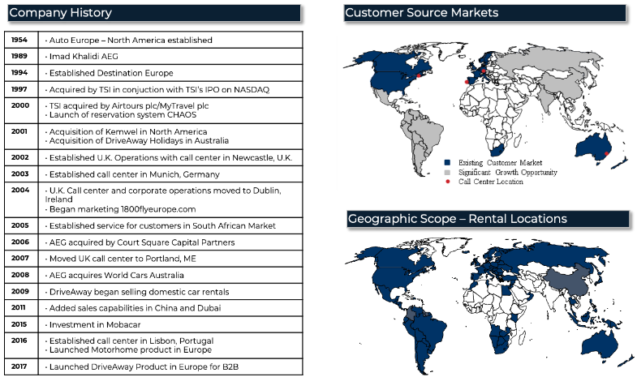
OUR HISTORY

Slide 5
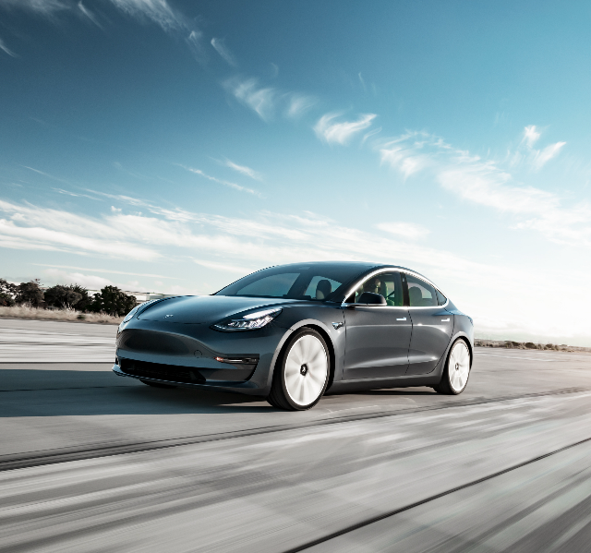
WHY US
GREAT PRICES AND THE BEST SERVICE SINCE 1954
For over 70 years, our commitment to transparency and superior service has made Auto Europe a trusted name and leader in the travel industry.

Slide 6
















Why choose Auto Europe:
BENEFITS
ONLY THE WORLD’S TOP CAR RENTAL SUPPLIERS

Slide 7

Why choose Auto Europe:
BENEFITS
Rates available at 24,000 pick-up locations worldwide
The best rates, availability and supplier connectivity in the industry
24/7 worldwide car rental support 1-800-970-0380) before, during & after travel
Unprecedented professional sales management TA support team
Dedicated post travel customer service department specializing in billing disputes & claim resolution
400 direct interfaces to the supplier reservation systems
Global call center operations in the US, Europe and Australia
24/7 IT Help Desk

Slide 8

Why choose Auto Europe:
BENEFITS
BEST CAR RENTAL RATES
IN EUROPE GUARANTEED!
We have the BEST PRICE GUARANTEE
Our promise to either beat or match any international car rental rate from a competitor with the same details and inclusions
beatrates@autoeurope.com https://www.autoeurope.com/beatrate/

Slide 9

Why choose Auto Europe:
BENEFITS
ADDED FLEXIBILITY
Free cancellation up until 48hrs before pick-up in all cases.
Cancellation Cover can be purchased for cancellations within 48 hours of pickup and when purchased we will refund the total rental or a pro-rated portion of the daily booking price, if your client cannot pick up their vehicle or needs to return it early.
Plus, you can earn commission on every new booking you make where Cancellation Cover has been added.

Slide 10


Why choose Auto Europe:
BENEFITS
INCREASED COMMISSION
Guaranteed to receive
between 10-15% commission
through Auto Europe
vs.
Potentially receiving 5%-10% commission
when using most suppliers directly.
Great Prices and Best Service

Slide 11

Why choose Auto Europe:
BENEFITS
EXPERIENCE MATTERS
Proudly celebrating over 70 years of experience
advocating, educating, adapting & supporting
our Advisor Partners.
You can count on Auto Europe to deliver industry leading insight, information & service with each call.

Slide 12

Why choose Auto Europe:
BENEFITS
24/7 SUPPORT
Around the clock rental support & client advocacy before, during & after the rental
International phone support from every country we service
Award-winning dedicated Customer Service Claims Department at your fingertips for all post travel claims!

Slide 13


Why choose Auto Europe:
BENEFITS
EARN 1 FREE DAY OF CAR RENTAL IN EUROPE
WITH EVERY CLIENT CAR RENTAL YOU BOOK
Traveling Outside of Europe?
We offer all our Travel Advisor Partners unique TA Discounts on all our various products, services and destinations.
For balance inquiries and coupon redemption email: tasales@autoeurope.com

Slide 14

Why choose Auto Europe:
BENEFITS
EXPERIENCED RESERVATION AGENTS
ONE CALL DOES IT ALL
Receive industry leading insight and service from experienced reservation agents in 15 languages with an average yearly abandoned rate lower than 5% .

Slide 15
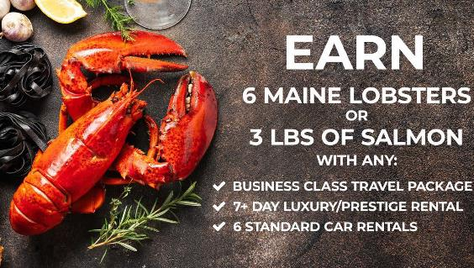
Why choose Auto Europe:
BENEFITS
2025 SEAFOOD REWARDS
Offer available for US residents only and will be available for delivery after travel is completed. Seafood Rewards are earned by the booking agent, for themselves or their client at the agent's choice. Offer valid for reservations booked now through December 31, 2025, for travel anytime in 2025. Offer valid per Business Class PNR and/or with any minimum 7-day luxury or prestige car rental, LDAR category/Mercedes E-Class or greater in Europe or the South Pacific. apply and qualify, business class packages must include business class airfare and hotel and/or car rental. Deliveries may be affected by weather and/or holiday delivery service by Fed Ex and is outside our control. If it is the agency's policy not to allow individually awarded incentives, it is up to the agency owner/manager to exclude the agent or agency. Additional restrictions apply, and offers are subject to change without notice.
DELIVERED FRESH FROM MAINE TO YOUR FRONT DOOR!

Slide 16

Products & Services

Slide 17










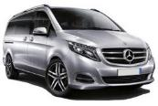




Products & Services
CAR CATEGORIES
EXAMPLES OF MODELS
MINI
ECONOMY
COMPACT
MIDSIZE
STANDARD
x 2
x 2
x 2
x 1
x 1
x 4
x 1
x 1
x 5
x 2
x 1
x 5
x 2
x 1
FULL SIZE
PREMIUM
SUV/4WD
LUXURY
x 5
x 2
x 2
x 5
x 2
x 3
x 5
x 2
x 3
x 5
x 2
x 3
CONVERTIBLE
PRESTIGE
MINIVAN
VAN 7 PASSENGERS
VAN 9 PASSENGERS
x 2
x 2
x 2
x 2
x 2
x 2
x 5
x 2
x 3
x 7
x 2
x 3
x 9
x 2
x 3

Slide 18

Products & Services
CAR RENTAL INSURANCE
Basic rates include third-party
insurance coverage (Fire Insurance and VAT) and optional liability waivers.
In addition, other rate structures may be available, including Inclusive Rates and Zero Deductible Rates. These will vary by country.

Slide 19

Products & Services
RESTRICTION FREE DRIVING
One Way Rentals Available: Domestic & International
One Way Fee: Always included in the Headline Price
Travel East Rates Available: Allows for travel from Western Europe to all Eastern European Countries

Slide 20


Products & Services
PRESTIGE SERVICES
Luxury, exotic sports car & specialty rentals
Vehicle delivery & collection to hotels, airports, cruise-ports and/or private residences
Out-of-hours pick up requests + meet & greet services

Slide 21
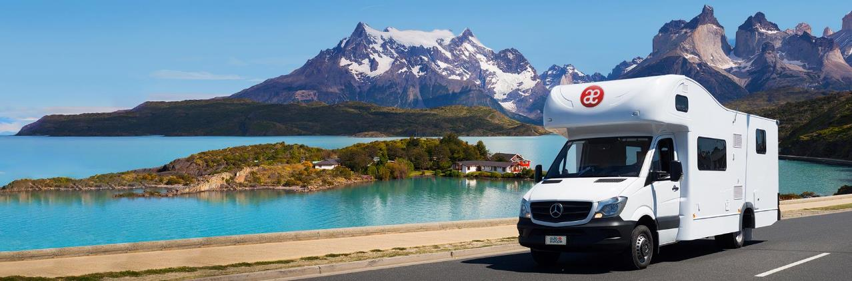

Products & Services
MOTORHOME RENTALS
Available in more than 40 countries worldwide
Over 500 pick-up locations on 5-continents
All Leading Motorhome suppliers worldwide

Slide 22

Special Offers

Slide 23

Products & Services
PROMOTIONS
Exclusive limited time deals, including:
Free additional driver and free guaranteed one-car class upgrades

Slide 24

Travel Packages

Slide 25
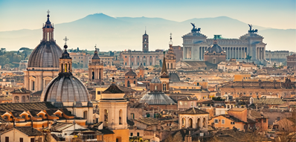

Travel Packages
CUSTOMIZED PACKAGES
ECONOMY-LEVEL PACKAGES
LUXURY-LEVEL PACKAGES
Round-trip business-class airfare including all taxes and fees
3-night stay at a 5-star centrally located hotel
3-night intermediate-sized car rental including VAT and mileage
GPS and MIFI Rentals
Round-trip economy-class airfare including all taxes and fees
3-night stay at a 3-star centrally located hotel
3-night economy-sized car rental including VAT and mileage
GPS and MIFI Rentals
Offer your clients incredible savings on travel to Europe when airfare, hotel, and car rentals are bundled together.
Create the perfect customized package for your client’s next trip to Europe!

Slide 26
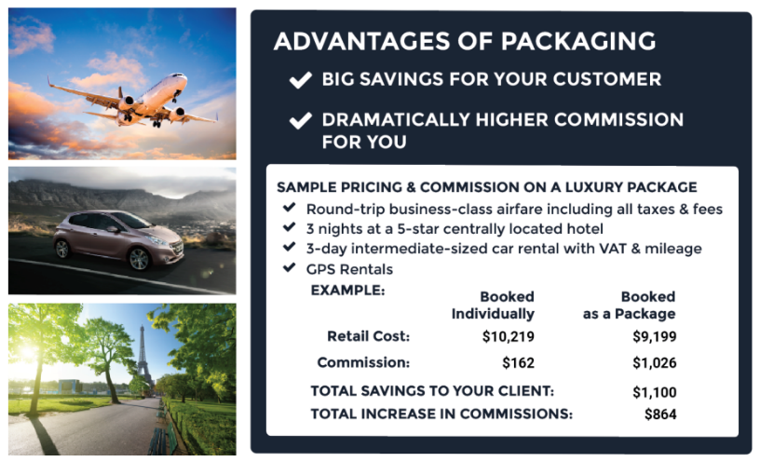
Travel Packages
BENEFITS

Slide 27

Travel Packages
GROUP TRAVEL
CUSTOM PACKAGES
EXCELLENT SERVICE
Flexible packages from high end to cost effective
Competitive net rates, bulk tickets without price display
Early space reservations, up to 9 months prior to departure
5% Discount on travel insurance
Experienced group specialists to help plan, book and manage your group needs
Flexible payments and ticketing deadlines
Emergency contact 24/7

Slide 28
Travel Packages
GROUP TRAVEL
WORLDWIDE AVAILABILITY
Ideal for family gatherings, sports teams, schools, religious events, specialty clubs, incentive travel or simply a group of friends.
Coach, premium economy, and business class airfare to Europe & beyond
3-, 4- & 5-star hotels worldwide
Worldwide car rental services

Slide 29

Products & Services
FLY INTERNATIONAL
We offer Travel Advisors the opportunity to secure the best flights to Europe at prices our competitors cannot match – especially for Business Class packages!
In order to get the largest discount and commission, flights must be packaged
with additional ground travel services

Slide 30

Products & Services
HOTELS
Our expertise also extends to 3-, 4- and 5-star hotels worldwide through
My Excellent Hotels with access to over 100,000 different properties.
Sort results by destination, price, or average traveler rating to find a room which offers the perfect balance of prime location and sophistication within your client‘s price range.
Visit www.myexcellenthotels.com to sign up for our B2B web booking tool.

Slide 31
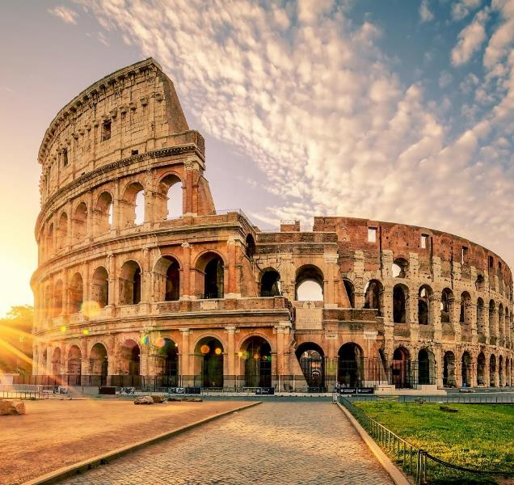

Benefits
TOURCRAFTERS
ITALY & THE BEST OF EUROPE
SERVICES WE OFFER:
Independent Custom Itineraries
Cruise Pre & Post Add-Ons
Private Guided Itineraries
Weddings & Honeymoons
Fly Drive Packages
Food & Wine Tours
Historical Villas
Escorted Tours and Groups
Rail - Trenitalia & Rail Europe

Slide 32

WE WILL CUSTOMIZE
ANY ITINERARY
Large selection of programs for every traveler and budget
The largest collection of tours & private services to Europe
Call center support with experienced staff
Competitive commissions

Slide 33
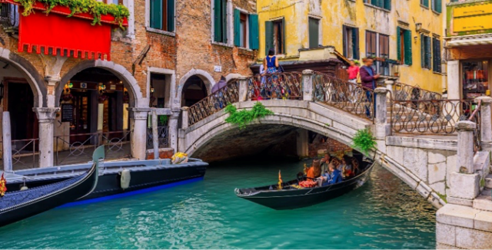

Benefits
TOP TYPES OF TOURS
Small Groups (3 to 16 participants)
Private Tours & Destination Services
Luxury Private Cruise
Extensions Personalized Self Drive Tours

Slide 34

Our Booking Solutions

Slide 35

HOW TO BOOK
TO BOOK ONLINE USING OUR NEW TRAVEL PARTNER PORTAL, VISIT:
https://partners.autoeurope.com
Call our Toll-Free Reservations Lines 24/7,
365 days-a-year: 1-800-223-5555
Or e-mail: reservations@autoeurope.com
Call our Airfare, Hotel, River Cruise & Group Packaging Department: 1-888-325-5544 Or e-mail: ticketing@autoeurope.com
Research, Browse and Book Hotels online
using our TA Exclusive Hotel Booking Site: www.myexcellenthotels.com or
call 1-888-325-5544

Slide 36
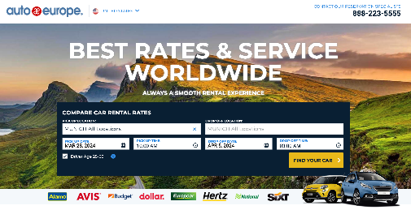
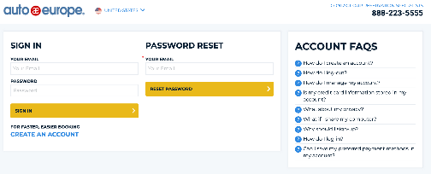
Reservation Tool:
TRAVEL PARTNER
Benefits of our
Travel Partner Link
Quick and easy to use
Multi language Tool
Booking management functionality
Reporting
https://www.autoeurope.com/agents-affiliates/

Slide 37
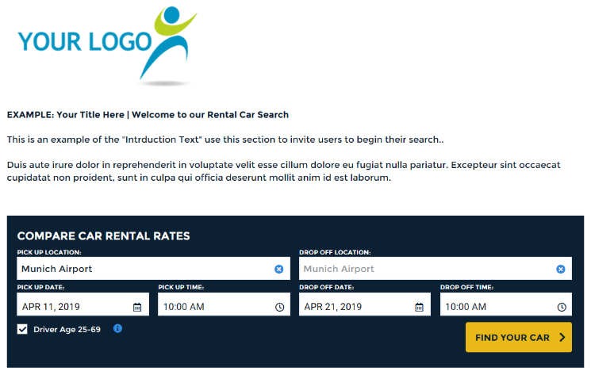
White Label Booking Solution:
WEB-AFFILIATE PROGRAM
Booking Solutions that allows you to send users through a custom branded booking process. The White-Label booking site can be used as a landing page or incorporated into your site.

Slide 38
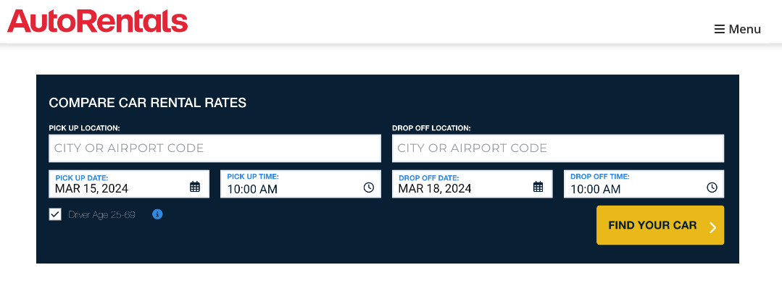
White Label :
BOOKING WIDGET

Slide 39
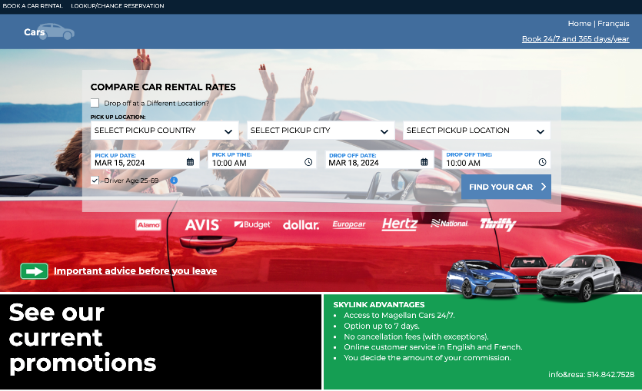
White Label :
BOOKING WIDGET

Slide 40
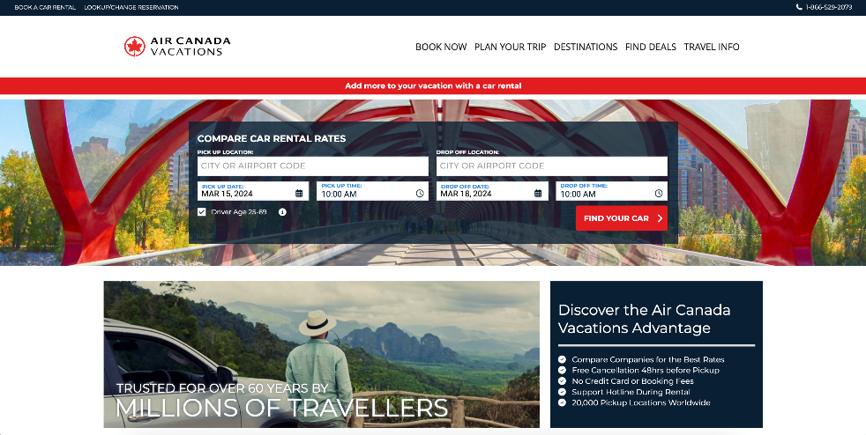
White Label :
BOOKING WIDGET

Slide 41
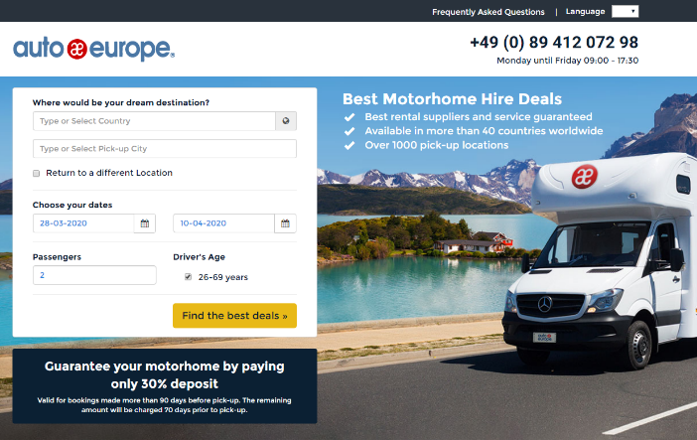
EASY ENTRY TO MOTORHOME IBE
https://www.autoeurope-motorhome.com/

Slide 42
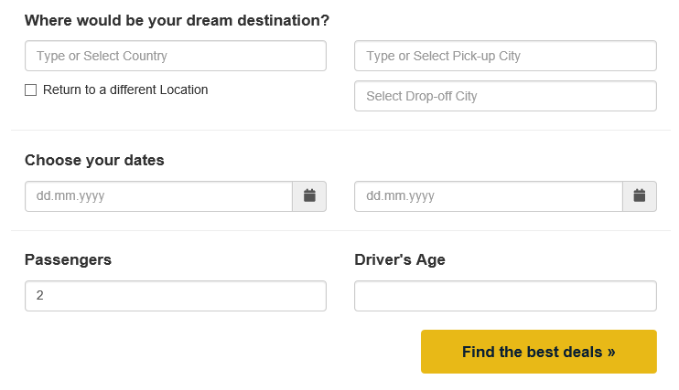
MOTORHOME WIDGET
It is possible to place a booking widget anywhere on your website.

Slide 43

Promotional Materials

Slide 44
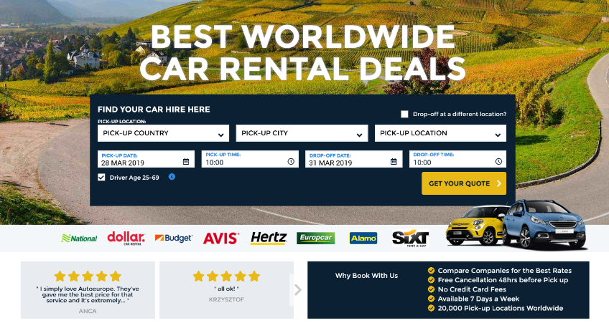
Promotional Materials
AFFILIATE LINKS
Possible to install an Affiliate link that redirects the client to our website.

Slide 45
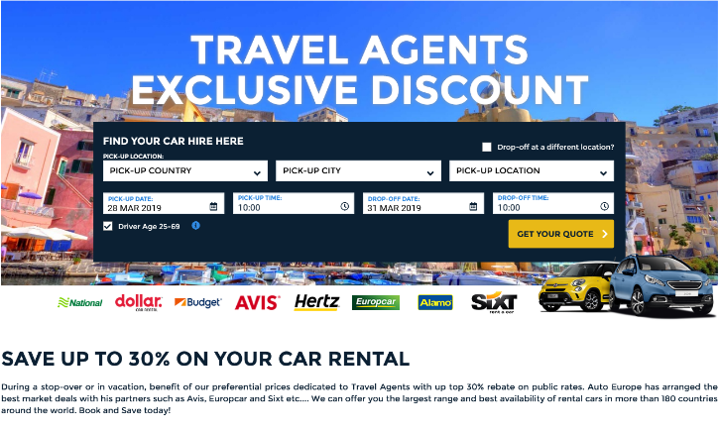
Promotional Materials
LANDING PAGE
Suitable option for a targeted audience
as you can choose a special picture and text.

Slide 46

Thank You!

